Slide 1
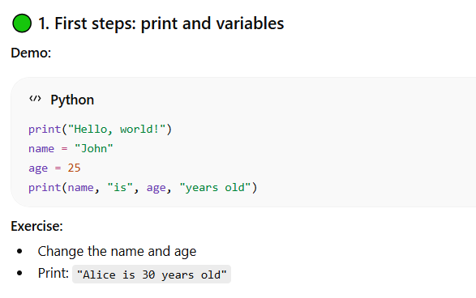

Slide 2
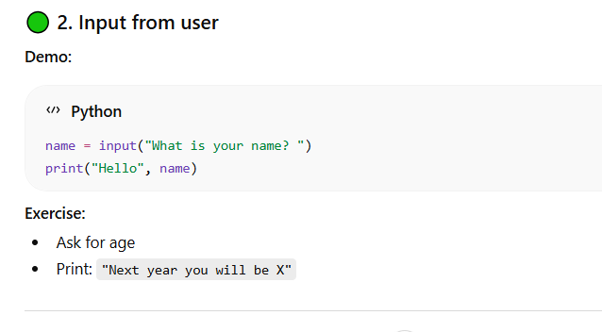

Slide 3
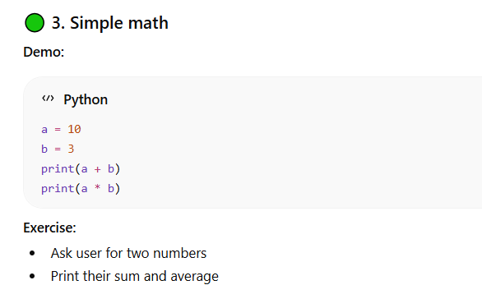

Slide 4
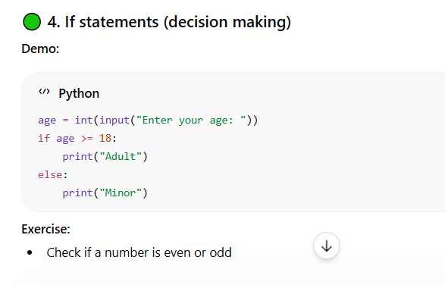

Slide 5
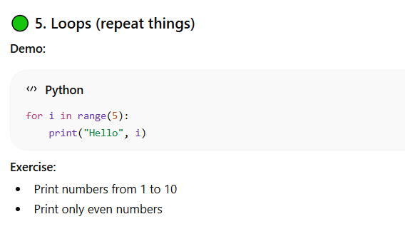

Slide 6
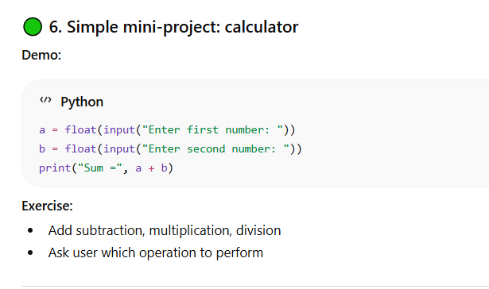

Slide 7
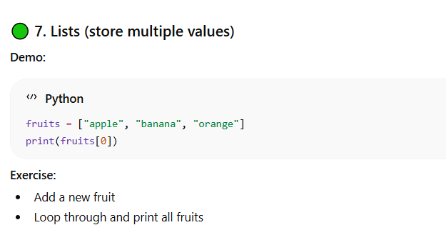

Slide 8
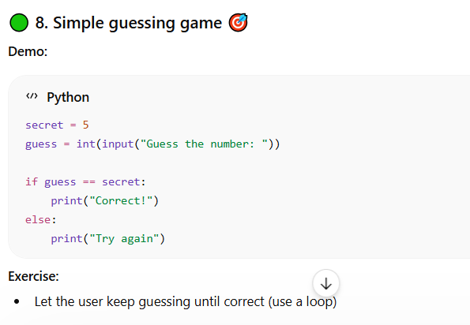

Slide 9
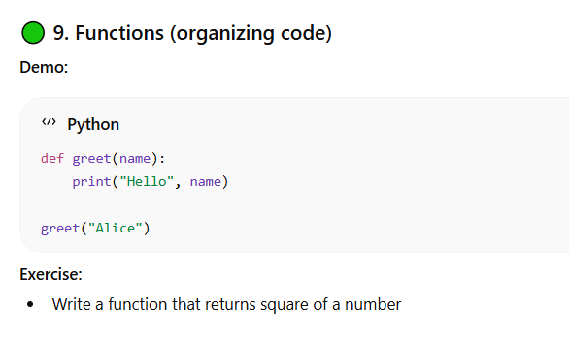

Slide 10
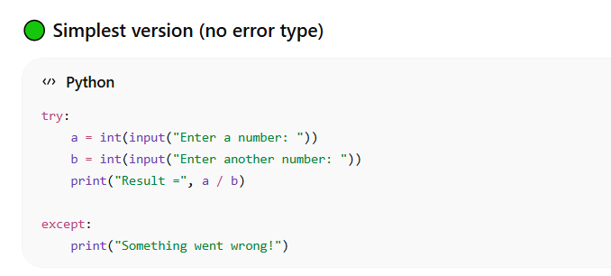

Slide 11
Program generate a random number between 1 and 50
Guess the number
No. is bigger
Y
Print Number is too big
Algorithm in the form of a flow chart
For the AI
No. is Smaller
Y
Print Number is too small
You guessed correctly
END

Slide 12
I am running python on Thonny IDE. Teach me how
to set up a text to speech python program

